Slide 1
New Approaches to Power Curve Adjustments in WakeBlaster
Philip Bradstock
Power Curve Working Group
1 February 2018, Hamburg
(c) ProPlanEn, 2018

Slide 2
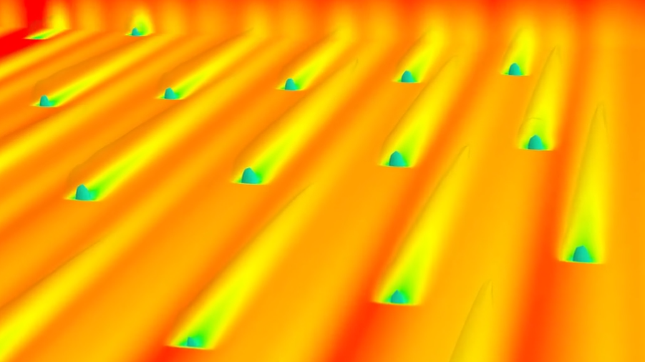

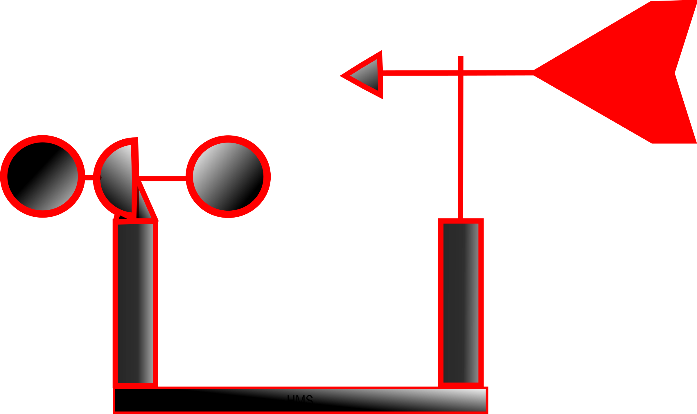
WakeBlaster
Measurements (SCADA or virtual)
3D RANS Wake Model
Power Capture

Slide 3
Power Capture Corrections
Turbulence
Air Density
Rotor Equivalent Wind Speed (REWS)
Shear
Wake profile
Yaw Misalignment

Slide 4
Turbulence – Zero Turbulence Power Curve
Current IEC method assumes constant Cp below rated:
Not true at low wind-speeds.
Not true just below rated

Slide 5
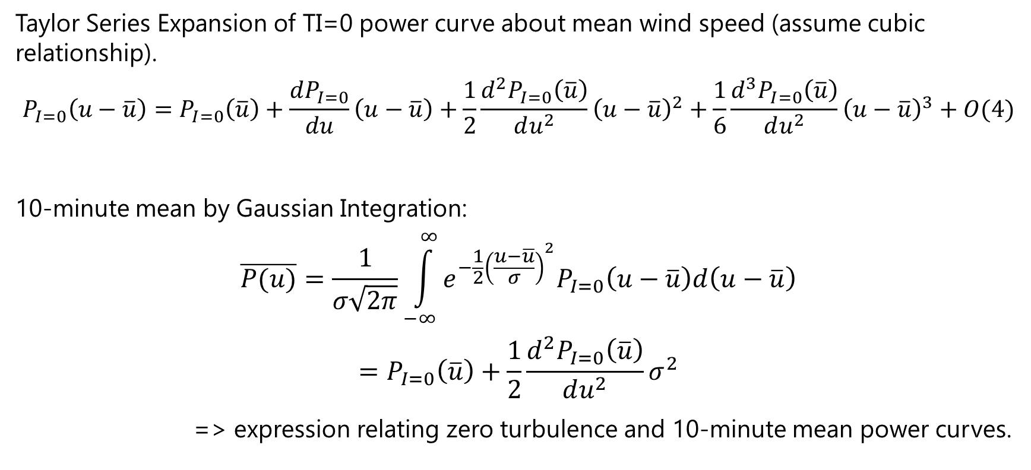
Zero TI power curve - Alternative Method
Taylor Series Expansion of TI=0 power curve about mean wind speed (assume cubic relationship).
$$P_{I=0}\left(u−\overline{u}\right)=P_{I=0}\left(\overline{u}\right)+\frac{dP_{I=0}}{du}\left(u−\overline{u}\right)+\frac{1}{2}\frac{d^{2}P_{I=0}\left(\overline{u}\right)}{du^{2}}{\left(u−\overline{u}\right)}^{2}+\frac{1}{6}\frac{d^{3}P_{I=0}\left(\overline{u}\right)}{du^{2}}{\left(u−\overline{u}\right)}^{3}+O(4)$$
10-minute mean by Gaussian Integration:
$$\overline{P(u)}=\frac{1}{σ\sqrt{2π}}\int_{−∞}^{∞}{e^{−\frac{1}{2}{\left(\frac{u−\overline{u}}{σ}\right)}^{2}}P_{I=0}\left(u−\overline{u}\right)d\left(u−\overline{u}\right)}$$
$$=P_{I=0}\left(\overline{u}\right)+\frac{1}{2}\frac{d^{2}P_{I=0}\left(\overline{u}\right)}{du^{2}}σ^{2}$$
=> expression relating zero turbulence and 10-minute mean power curves.
$P$ = power $u$ = wind speed $\overline{u}$ = 10-min mean wind speed $I$ = turbulence intensity

Slide 6

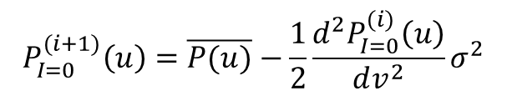


Zero TI power curve - Alternative Method
$$P_{I=0}^{(0)}\left(u\right)=\overline{P(u)}$$
Apex Correction:
Find point of inflection and extrapolate with cubic
Rated Power Correction:
Limit all values to rated power
$$P_{I=0}^{(i+1)}\left(u\right)=\overline{P(u)}−\frac{1}{2}\frac{d^{2}P_{I=0}^{(i)}\left(u\right)}{dv^{2}}σ^{2}$$
Finite difference method:
$$\frac{d^{2}P_{I=0}^{(i)}\left(u\right)}{dv^{2}}=\frac{P\left(u−σ\right)−2P\left(u\right)+P\left(u+σ\right)}{σ^{2}}$$
$$P_{I=0}^{}\left(u\right)$$
Warning: Iteration has a tendency to diverge – limit number of iterations

Slide 7

Alternative Method Testing
Measured 10-min power curve
TI=0 power curve
$$Error Δ$$
Simulated 10-min power curve

Slide 8
Alternative Method Testing
Measured 10-min power curve
TI=0 power curve
$$Error Δ$$
Simulated 10-min power curve

Slide 9
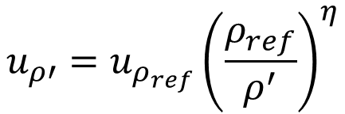

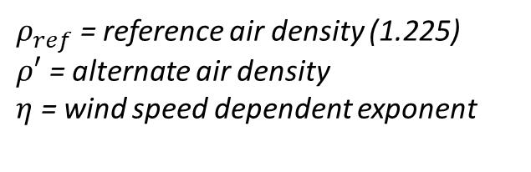
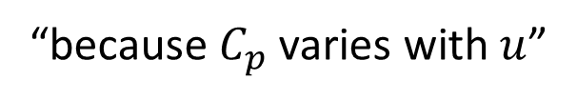
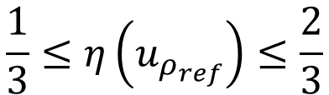
Air Density Adjustment
IEC method:
Svenningsen method (semi-empirical):
$$u_{ρ′}=u_{ρ_{ref}}{\left(\frac{ρ_{ref}}{ρ^{′}}\right)}^{\frac{1}{3}}$$
$ρ_{ref}$ = reference air density (1.225)
$ρ′$ = alternate air density
$η$ = wind speed dependent exponent
$$u_{ρ′}=u_{ρ_{ref}}{\left(\frac{ρ_{ref}}{ρ^{′}}\right)}^{η}$$
$$\frac{1}{3}≤η\left(u_{ρ_{ref}}\right)≤\frac{2}{3}$$
“because $C_{p}$ varies with $u$”

Slide 10


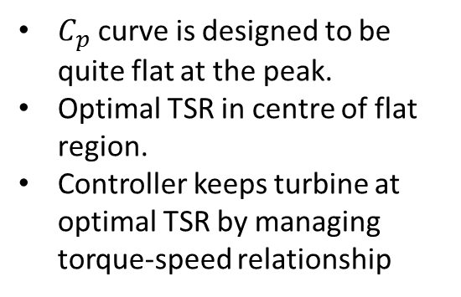
Air Density Adjustment
$λ$ = tip-speed ratio
$C_{p}≠f(u,ρ)$ directly, $C_{p}=f(λ)$
$C_{p}$ curve is designed to be quite flat at the peak.
Optimal TSR in centre of flat region.
Controller keeps turbine at optimal TSR by managing torque-speed relationship

Slide 11
Air Density Adjustment
$λ$ = tip-speed ratio
$C_{p}≠f(u,ρ)$ directly, $C_{p}=f(λ)$
$C_{p}$ curve is designed to be quite flat at the peak.
Optimal TSR in centre of flat region.
Controller keeps turbine at optimal TSR by managing torque-speed relationship

Slide 12
Air Density Adjustment
If the controller is not modified, a change in air density moves the TSR values.
Flat top => no change in Cp for small changes in density.
=> 1/3 power rule is valid.
STALL!!
Large change in air density:
=> change in Cp
Operates in stall at rated
1/3 power rule no longer valid
Controllers for high-altitude sites modified to correct TSR

Slide 13

Air Density Adjustment
1/3 power rule should be implemented on TI=0 power curve.
Due to large uncertainty in $P_{I=0}(u)$, may cause more problems than it solves.

Slide 14
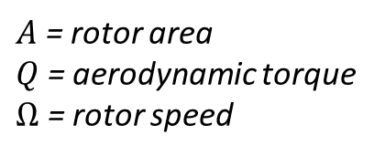






Rotor Equivalent Wind Speed
Current practice based on $P∝u^{3}$:
BUT:
WakeBlaster calibration & validation shows linear average to be more representative:
$$u_{REWS}=\sqrt[3]{\frac{1}{A}\int_{A}{u^{3}dA}}$$
$A$ = rotor area
$Q$ = aerodynamic torque
$Ω$ = rotor speed
$$P=QΩ$$
$Ω$ is fixed for whole rotor
$$Q∝u^{2}$$
and rotor will operate at varying non-optimal angles of attack.
$$u_{REWS}=\frac{1}{A}\int_{A}{udA}$$

Slide 15
Any Questions?
philip.bradstock@proplanen.com
wakeblaster@proplanen.com

